Slide 1
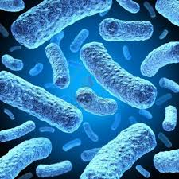
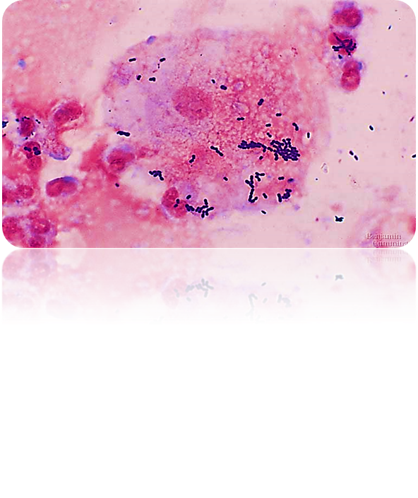
Cell biology Lec (2)
Prokaryotes

Slide 2

Prokaryotes
1- They are everywhere, they exist almost everywhere, including places where eukaryotes cannot.
2- Prokaryotic cells are cells that do not have a true nucleus or most other cell organelles. Organisms that have prokaryotic cells are unicellular :
A. The nucleoid region in a prokaryotic cell consists of a concentrated mass of DNA.
B. A prokaryote may have a plasmid in addition to its major chromosome.

Slide 3

Prokaryotes
3. Bacteria and Cyanophytes are the two main branches of prokaryote.
4. Most bacteria have just one chromosome that is circular, which can range from about 160,000 base pairs (bp) to 12,200,000 bp. They also contain plasmids, which are small circular pieces of DNA that replicate independently of the chromosome.

Slide 4

Prokaryotes
5. Some bacteria can form endospores. These are tough, dormant structures that the bacteria can reduce themselves to under starvation conditions when not enough nutrients are available.
6. Most prokaryotes are useful; we could not live without them. For example, a large ration of the oxygen we breathe comes from prokaryotes in the ocean, using the CO₂ dissolved in the water, and making more "space" for CO₂ from the atmosphere to be absorbed by the ocean. In addition, they live in our gut.
7. Some cause diseases; ex. There are wide varieties of diseases caused by prokaryotes...for example bacterial meningitis, salmonella, diphtheria ….many others

Slide 5
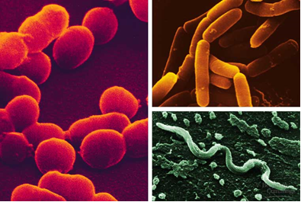
Prokaryotes
8. Prokaryotes are small 1-5 μm in size; but some can be seen by the naked eye, whereas Eukaryotic cells are typically 10-100 μm in diameter.
9.Three (3) common shapes: cocci (round); bacilli (rod); helical (spiral).

Slide 6
Prokaryotes
10. Almost prokaryotes have cell wall external to the plasma membrane.
11. The cell wall contains peptidoglycan, a molecule made of sugars and amino acids that gives the cell wall its structure and is thicker in some bacteria than others.

Slide 7
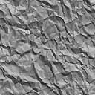
Prokaryotes
12. Bacteria are grouped according to cell wall :
a. Gram-positive bacteria: have simple, thick cell walls. Their cell walls are composed of large amount of peptidoglycan.
b. Gram-negative bacteria: bacteria have less peptidoglycan and are more complex.
- Gram-negative bacteria are typically more resistant to host immune defenses and antibiotics.

Slide 8
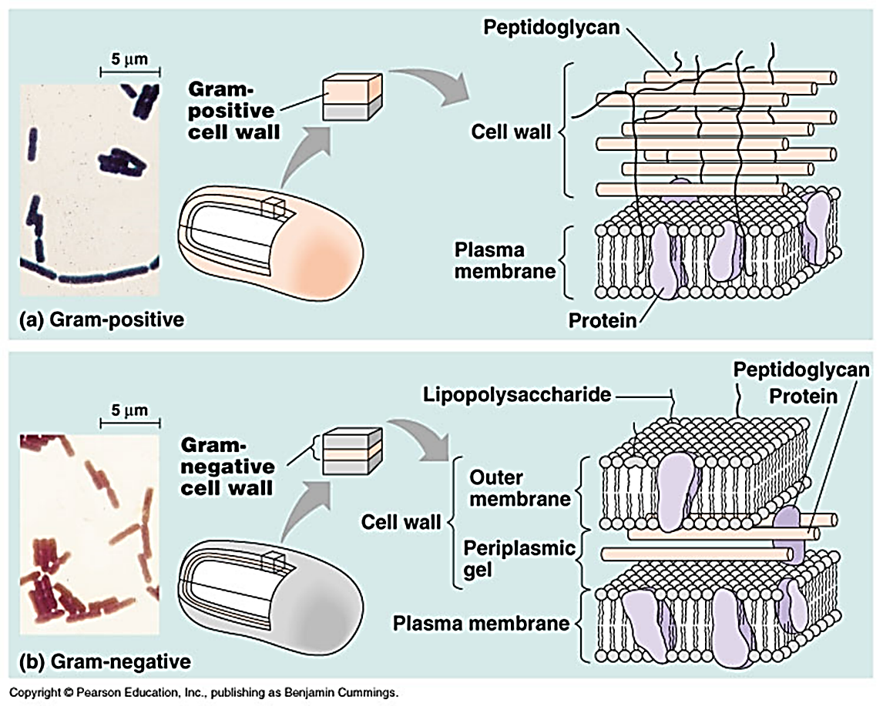
Prokaryotes

Slide 9
Prokaryotes
13. Most prokaryotes have sticky protective layer and enable them to adhere to substrates called capsule.
14. Many prokaryotes are motile.
15. Many prokaryotes move toward or away from a stimulus = taxis. Chemotaxis is the movement toward or away from a chemical.

Slide 10
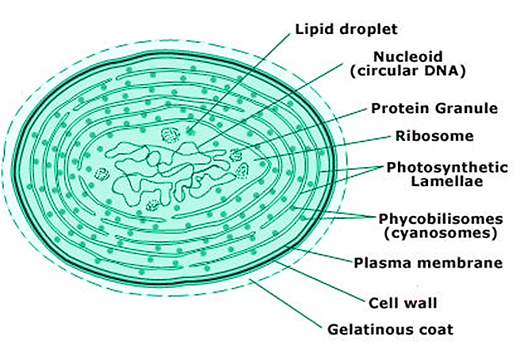
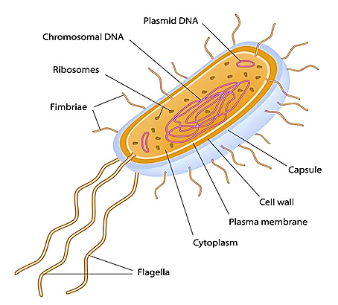
Bacteria VS Blue green algae

